Slide 1
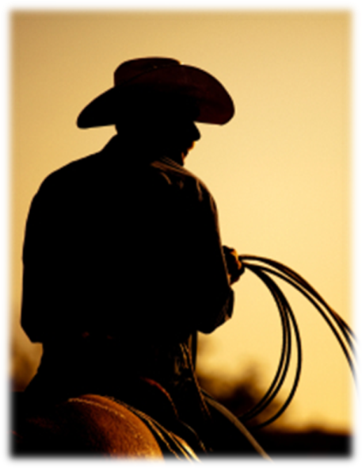
A Systems Approach to Ranching
Clay P. Mathis
King Ranch® Institute for Ranch
Management
C. P. Mathis, K. C. McCuistion, and R. D. Rhoades

Slide 2
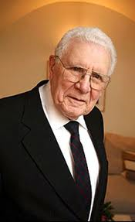
Understand the Problem First!
“We don’t need better solutions, we need better thinking about problems”
Russell L. Ackoff, PhD
Anheuser-Busch Professor Emeritus
of Management/Systems Science
Wharton School, Univ. of Pennsylvania

Slide 3
Overview
Philosophical discussion
  Future
  Trends
  How We Think!
Ranch Business
  Priorities
  Risk
Systems Thinking
  Finding Leverage
  Iceberg Concept
  Example: Cattle vs. Wildlife Management

Slide 4
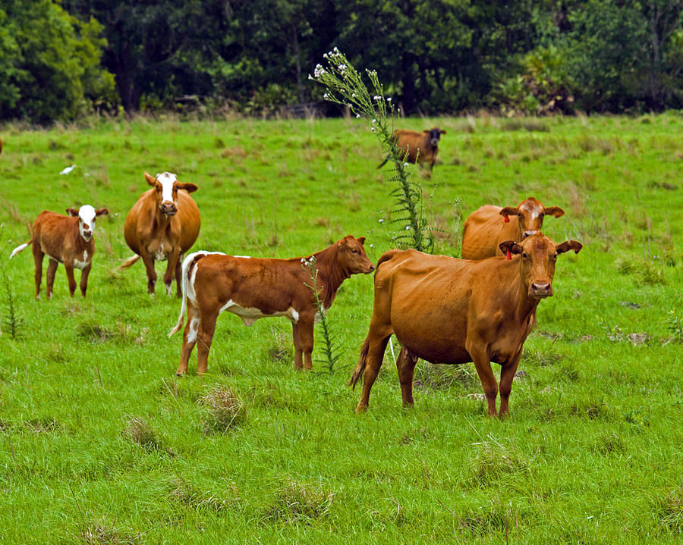
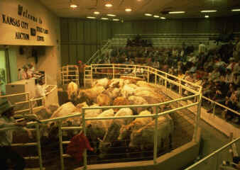
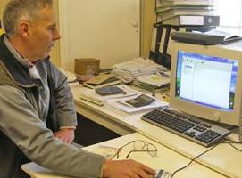
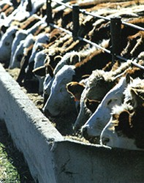
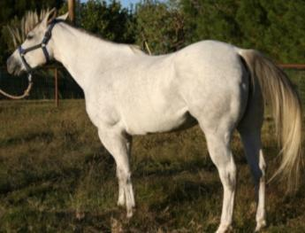
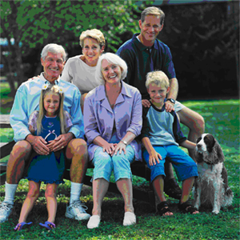
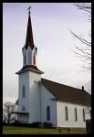
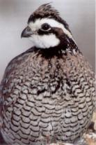
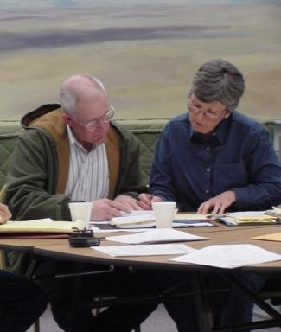
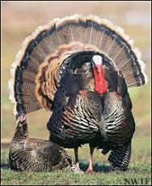
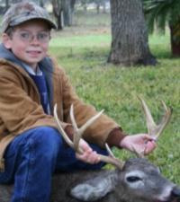
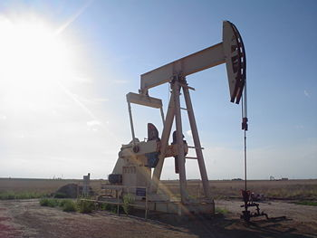
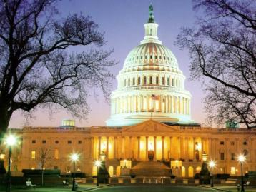

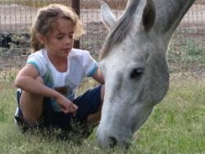
The Big Picture

Slide 5
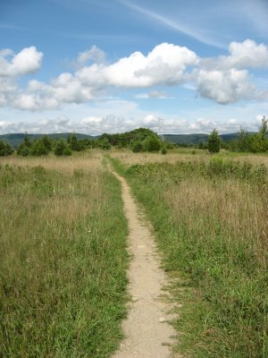
The Future…
"…the future is becoming much less predictable.”
              Dr. Michael Boehlje
              Distinguished Professor of Economics
              Purdue University

Slide 6
Important Trends
  Industry Wide
    ↑ Consumer interest in food production practices
    ↑ World population/food demand
    ↑ Regulations and complexity of business
    ↓ U.S. cowherd
  At the Ranch
    ↑ Climate variation (?)
    ↑ Cattle prices
    ↑ Feed prices
    ↑ Land values and fragmentation
    ↓ Willing and skilled ranch labor
How will your operation be successful?

Slide 7
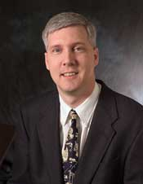
Adaptability!
“It is not the well adapted that will thrive, but the adaptable.”
Michael Swanson, PhD
Chief Agricultural Economist
Wells Fargo

Slide 8
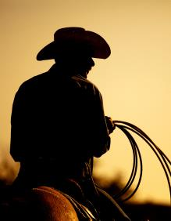
What will you do to prepare for a less predictable future?
How will you think?
  Tactical
  Strategic
  Both!
What will be your decision-making perspective?

Slide 9
Creative Destruction
…suggestion by Charles Koch, CEO Koch Industries, Inc.
(The Science of Success, 2007)
  Every seven years a company or organization should go through the process of recreating their business entity from scratch
    CREATIVELY destroying the old model
    Rebuilding a more modern approach
    ***this does not imply ignoring our ranching heritage

Slide 10
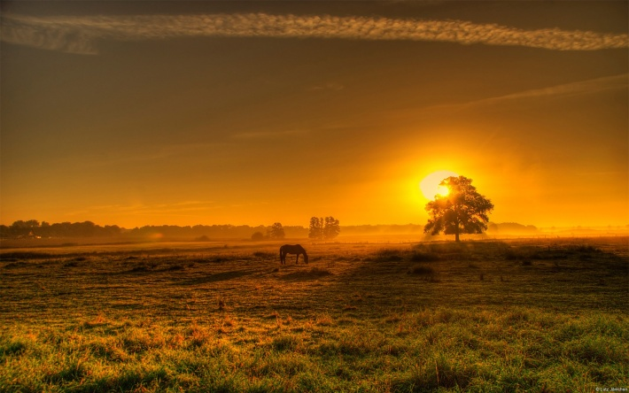
Key Components
Flexible
Opportunistic
Clarity of Vision

Slide 11

How do we create a more resilient ranching operation?
A Systems Approach…
  A mindset or way of thinking
  Seeing the whole…and how the parts are interconnected
Find LEVERAGE!

Slide 12
Leverage Points
Characteristics
  Long lasting and self sustaining
  Change long term patterns of performance
  Entrenched mental models
  Stop or doing something
  Start or doing
Task: Find a few leverage points that solve problems and/or create greater flexibility!

Slide 13
At The Ranch…
Income
Expenses
Risk
Photo by Joann Meeker

Slide 14
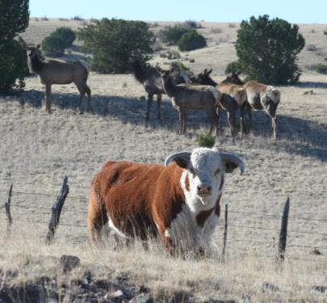
Typical Sources of Ranch Revenue
Livestock
  Cattle
Wildlife
Minerals
Other?
= Total Ranch Income
Know the trade-offs to find BALANCE!

Slide 15
Cow/Calf Expenses
SW SPA Database - 2000 to 2012
$/Cow Exposed
Source: Stan Bevers, TAMU

Slide 16
Southwest SPA Results
Expense Breakdown per Female
The Big Three:
  Labor
  Feed
  Depreciation
Average Total Cost per Cow = $588
Average of 78 herds, 2006-2012
*
Source: Stan Bevers, TAMU

Slide 17
Primary Risk in Florida ?
What do we know about risk to ranching in Florida?
  Energy cost - Fertilizer and freight
  Regulatory creep = increasing cost
  Availability of water for Ag use
  Qualified labor
Must design a ranching system to reduce exposure risk inherent to your operation!!
  HOW?

Slide 18
Components of Success
  Flexible to protect the core business
  Enterprise diverse to spread risk
  Managed for the good of the whole ranch, not to maximize the pieces
There is no “best” mix of enterprises or practices for ranching!

Slide 19
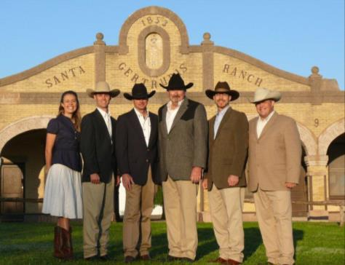
Barriers to Success?
What’s your Problem/Challenge?
      …are the solutions simple?
Systems Project -

Slide 20
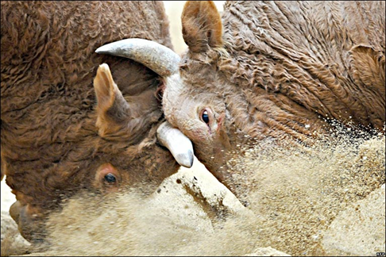
Identifying and Bridging The Gap
Desired
What Management Wants
  Maximized, long-term profit from multiple ranch enterprises
Gap/Tension
Actual
What Management Has
  Multiple enterprises but profit is not maximized because of conflict among profit centers
Notes:
ST helps you
Understand this tension “admire the problem”
Identify root causes of complex, chronic problems
Anticipate unintended consequences of proposed solutions
Clarify leverage points for sustainable improvement
Anticipate and prevent difficulties from becoming major problems

Slide 21
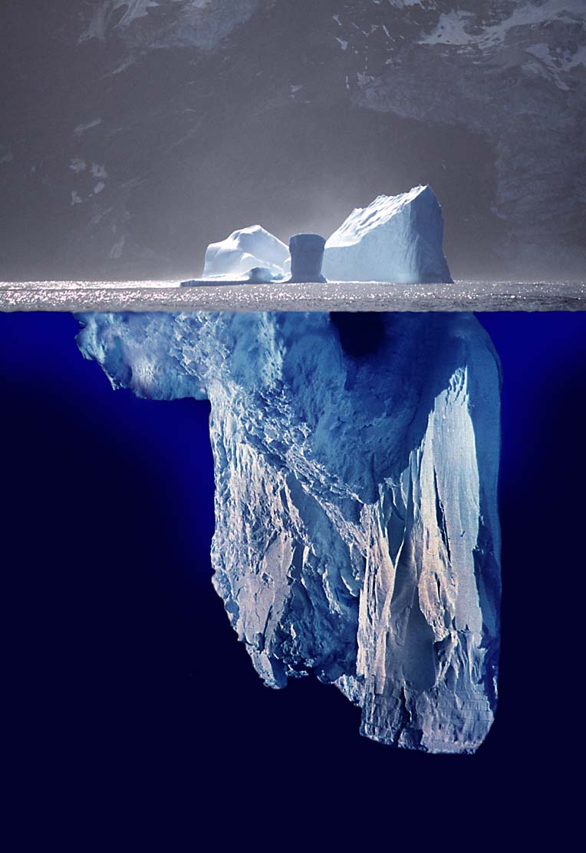
Iceberg Concept

Slide 22
Iceberg Concept
What is happening?
Event
Learning
Trends
and
Patterns
What has been
happening?
Structures
Leverage
Why?

Slide 23
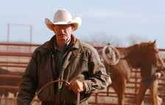
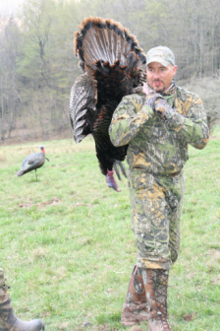
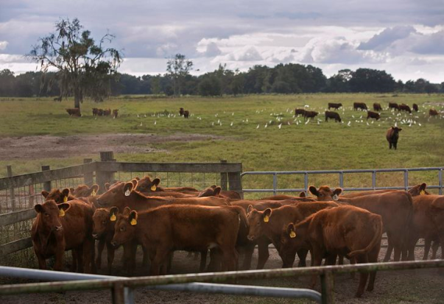
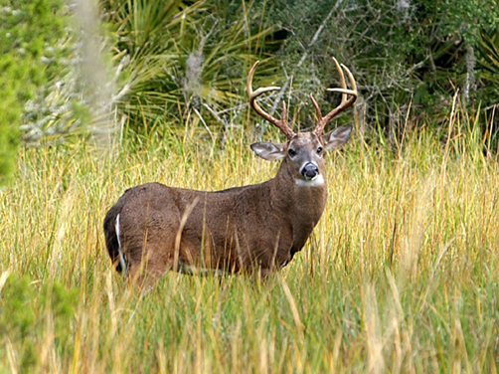
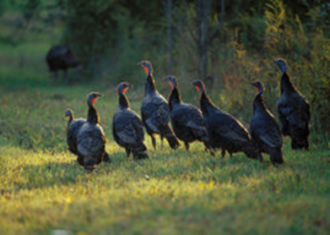
Consider Conflict between Profit Center Managers: Cattle vs. Wildlife

Slide 24

Getting to “WHY” …Cattle vs. Wildlife
What is happening?
  Conflict between cattle and wildlife managers
What has been happening?
  Ownership desires maximal profit
  ↑ employees supporting wildlife enterprise
  ↑ wildlife revenue
  ↑ wildlife population
  ↑ competition for habitat/space
  ↓ % revenue from cattle
  ↑ change form traditional cattle ranching
  ↑ ranch rules/management parameters
  ↑ complexity of natural resources management
  ↑ complexity of whole ranch
WHY?
Notes:
A good question…so good that when in the systems thinking class that I teach to KRIRM students, one of the groups last fall tried to answer the focusing question of “Why is it so difficult to cost-effectively manage through drought?” They used this Iceberg concept to understand the issue and built a map…causal loop diagram showing the complexity of the issue.

Slide 25
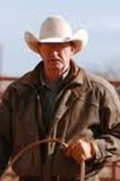
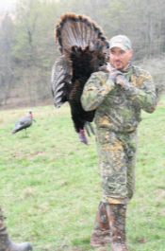
Mental Models
Cattle Managers
  maximize profit of cattle operation
  maintain maximal cows within sustainable grazing
  hunting limits my ability to rotate grazing
  food plots reduce my grazing acreage
Wildlife Managers
  maximize hunting profit
  ↑ wildlife population
  do more to provide hunters success and great experience
    Minimize hunt disruption – rules!
  need more food plots

Slide 26
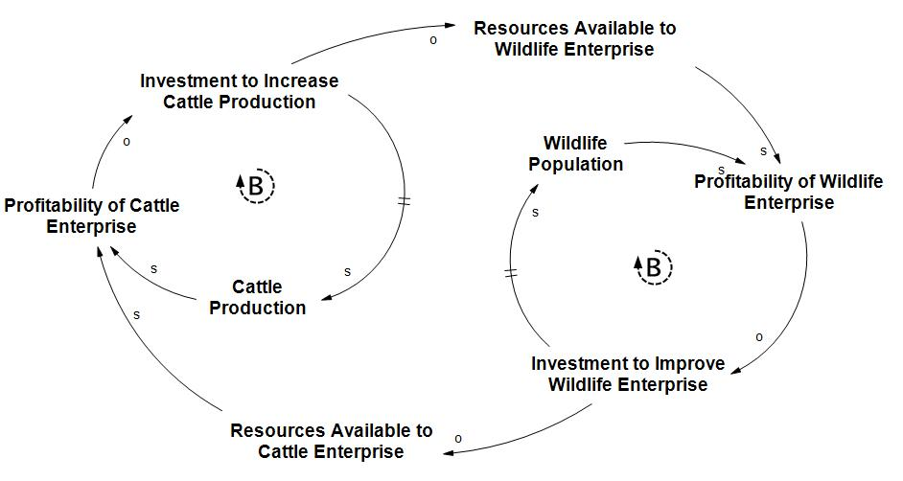
Structure of the Problem

Slide 27
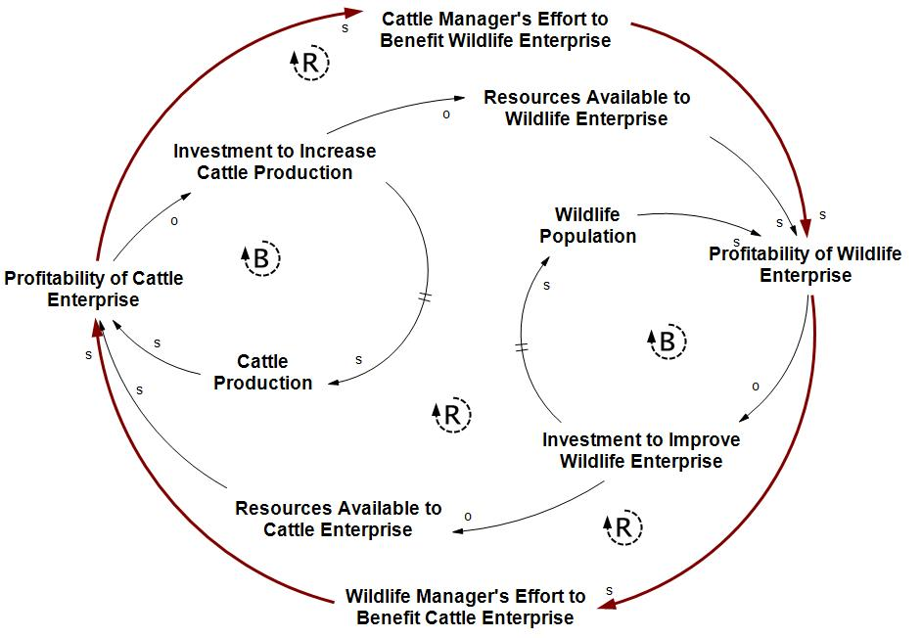
  Structure of the Problem + Ideal

Slide 28
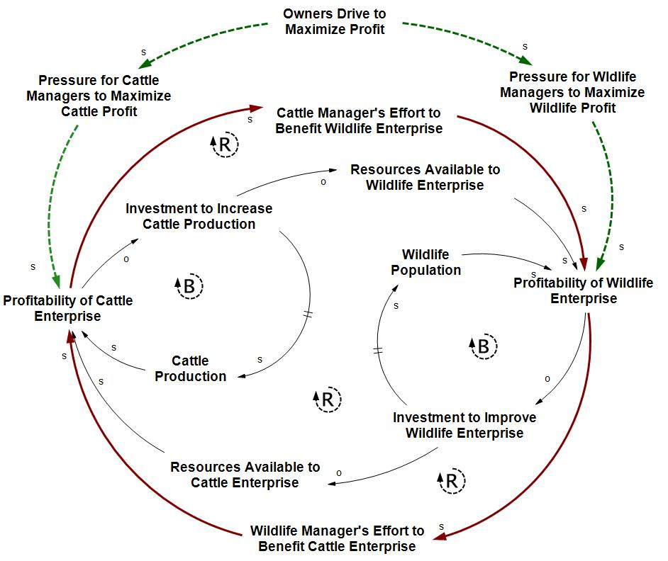
Other Drivers of the System

Slide 29
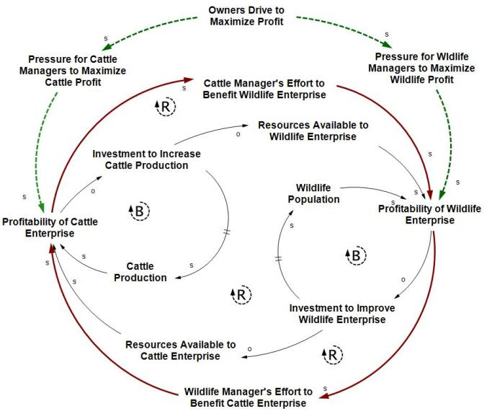
Potential High Impact Solutions
Communication
  Everyone must understand the whole picture
Understanding
  Acknowledgement across the ranch employees that both cattle and wildlife cannot be maximized…
    Optimize the entities to maximize achievement of ranch goals
Incentive
  Bonus structure must reward mutual success

Slide 30

Summary
Consider “Creative Destruction”
Use a “Systems Approach” to Problem Solving
    What is happening?
    What has been happening?
    Why?
Look for Leverage Points that will help your Ranching Enterprise be more Flexible
Managed for the good of the whole ranch, not to maximize the pieces!

Slide 31
Understand the Problem First!
“We don’t need better solutions, we need better thinking about problems”
Russell L. Ackoff, PhD
Anheuser-Busch Professor Emeritus
of Management/Systems Science
Wharton School, Univ. of Pennsylvania

Slide 32
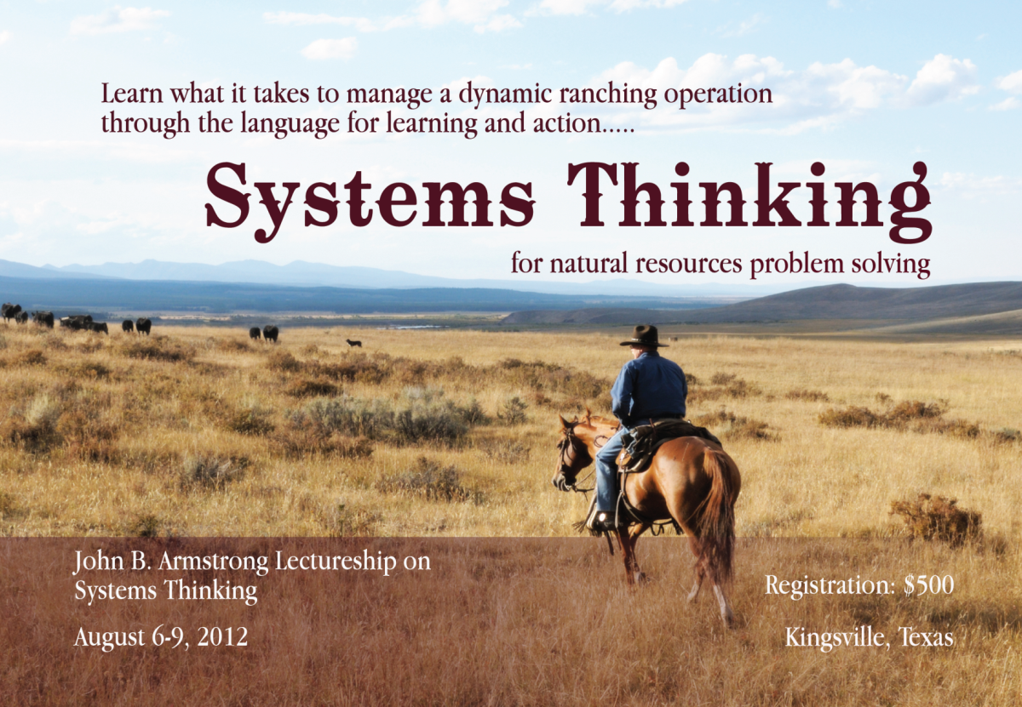
More on Systems Thinking
August 11-14, 2014

Slide 33
Thank You!
Clay P. Mathis
Director and Robert J. Kleberg, Jr. and Helen C. Kleberg Endowed Chair
King Ranch® Institute for Ranch Management
www.krirm.tamuk.edu

